Slide 1
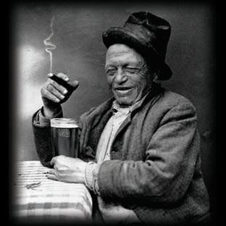
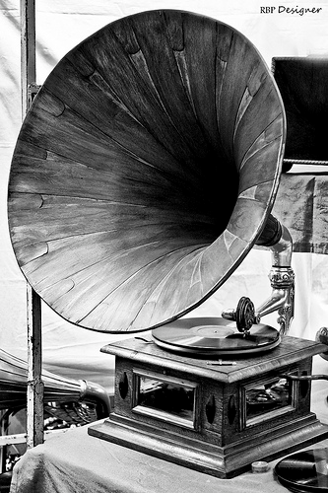
Ralph Ellison Imitation

Slide 2
Brainstorm
Think back to conflicts you have witnessed between two other people. List as many as you can.
Star any of these conflicts that also ended up affecting you—either emotionally or in some other way
Select one of the starred conflicts to be the subject of your pastiche.

Slide 3
Paragraph One:
1-2 sentence description of Person A (NOT the conflict); this paragraph should establish a critical tone
3-4 sentences describing the conflict; include description and dialogue
1-2 sentences describing negative effects of the conflict on you
Conclude paragraph with a more positive sentiment about Person A—an understanding, concession, or good wish

Slide 4
Paragraph Two:
Begin with a contrasting transition (No, Still, Nevertheless, etc.)
Describe in 2-3 sentences a common experience you shared with Person A
Your objective is to shift from a critical tone in paragraph one to a more sympathetic tone

Slide 5
Paragraph Three:
Think about the motivations and experiences of Person B. What struggles did they face? What were their hopes? Trials?
Describe in a more sympathetic tone the background of Person B.
Towards the end of this paragraph connect the conflict between Persons A and B to a wider, more significant type of conflict

Slide 6
Paragraph Four:
Describe the effect the conflict between Persons A and B had on you using the most concrete diction possible—create strong imagery
Include in this paragraph a list of 3-4 metaphorical descriptions
Conclude this paragraph with a rhetorical question which reveals an insight into yourself or the argument of your essay

Slide 7
Paragraph Four (Optional):
In Ellison’s fourth paragraph, there is that one sentence about him calling the cops on the neighbor who played his music too loudly. This is a similar conflict, but he judges this person more harshly.
Is there any experience like that which would fit into your fourth paragraph?

